Slide 1

PurePlay: An AI-Powered Video Filtering System
Child-Safe Media Consumption Platform
Maaz Bin Rashid(SP23-BAI-023)
& Syed Zubair(SP23-BCS-094)
COMSATS University Islamabad

Slide 2
Problem Statement
• Existing parental controls block entire videos only
• Unsafe content still appears during playback
• Keyword filtering misses visual NSFW content
• Guardians lack transparency in moderation decisions

Slide 3
Project Aim
• Build AI-powered video moderation system
• Detect NSFW visuals and toxic speech
• Automatically blur and mute harmful segments
• Create safe viewing environment for children

Slide 4

Existing Solutions
• YouTube Safe Search ? title-level filtering
• Netflix Controls ? age-rating restrictions
• TV Guardian ? profanity filtering only
• No existing system provides timestamp-level moderation

Slide 5
Proposed Solution
• AI-powered media moderation platform
• CNN-based NSFW visual detection
• Whisper + Detoxify for audio toxicity detection
• Timestamp-level blur and mute censorship

Slide 6
Objectives
1. Develop secure guardian authentication
2. Implement profile-based restrictions
3. Detect harmful visual and audio content
4. Apply automated censorship rendering
5. Provide explainable AI moderation timeline

Slide 7
System Modules
• User & Profile Management
• Media Upload & Preprocessing
• NSFW Detection Engine
• Audio Toxicity Detection
• Censorship Rendering Engine

Slide 8
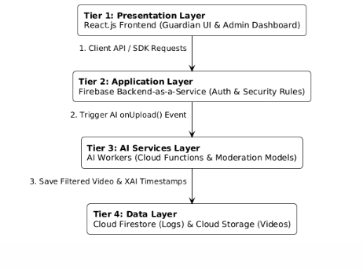
System Architecture

Slide 9
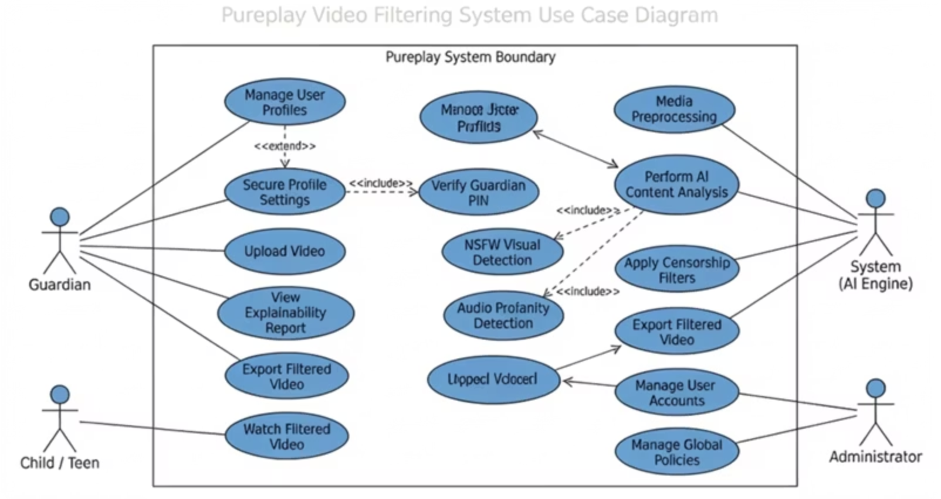
Use Case Diagram

Slide 10
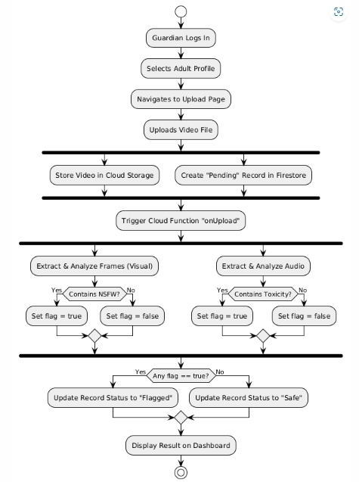
Activity Diagram

Slide 11
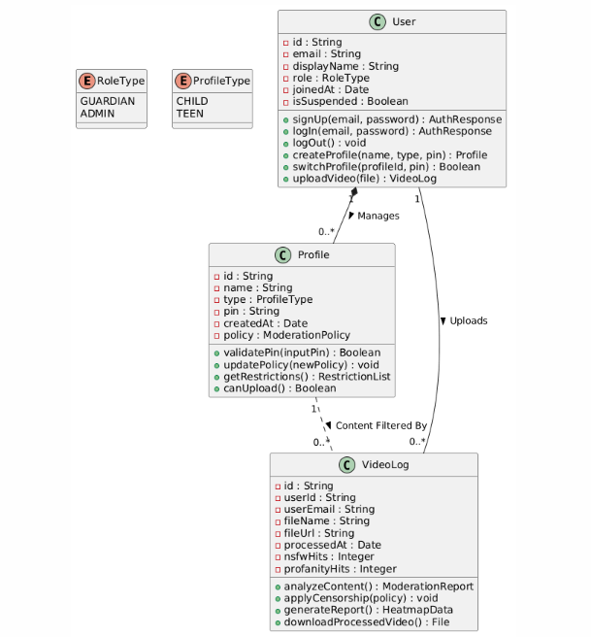
Class Diagram

Slide 12
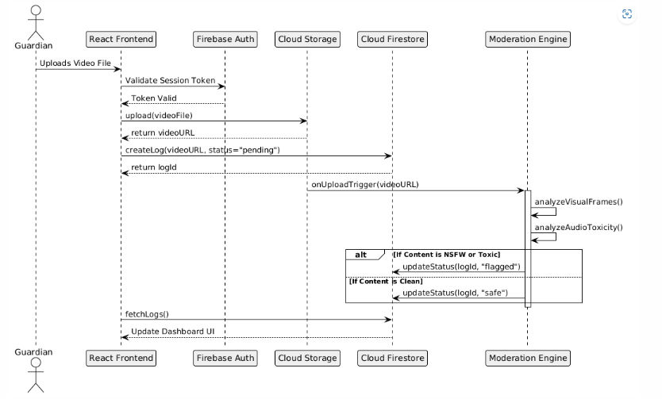
Sequence Diagram

Slide 13
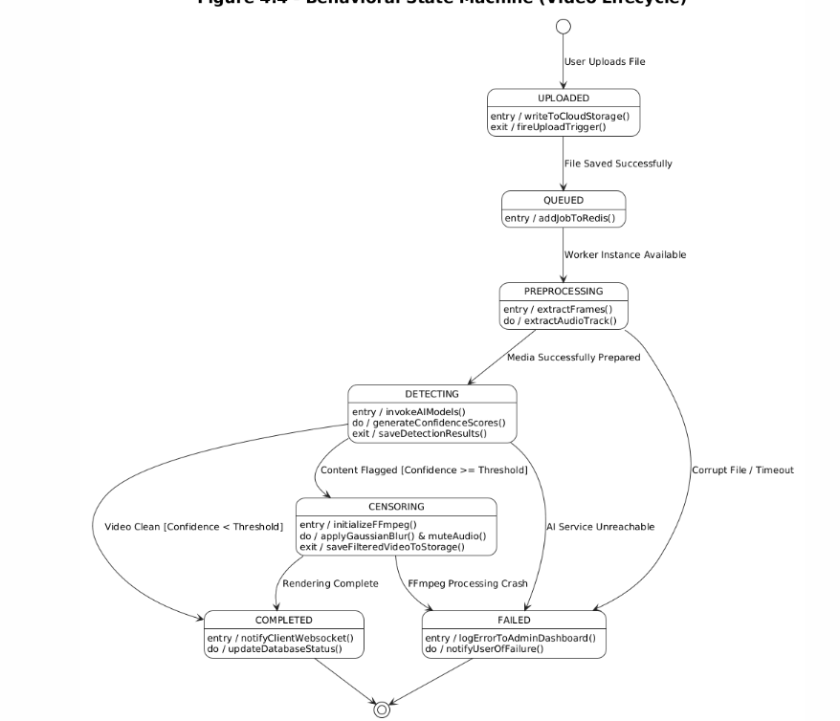
State Transition Diagram

Slide 14
Methodology
1. Upload video
2. Extract frames and audio
3. Detect NSFW content using CNN
4. Convert speech to text using Whisper
5. Detect toxicity using Detoxify
6. Blur and mute harmful content

Slide 15
Tools & Technologies
Languages: Python, JavaScript
Frontend: React.js + Vite
Backend: Django REST Framework
Database: Firebase Firestore
AI Models: NudeNet, Whisper, Detoxify
Deployment: Vercel + GitHub Actions

Slide 16
Testing & Evaluation
• Unit Testing for authentication and profile security
• Functional Testing for video moderation
• Business Rule Testing for censorship logic
• Integration Testing for full AI pipeline

Slide 17
Expected Outcomes
• Intelligent child-safe media platform
• Automated harmful content moderation
• Explainable AI moderation reports
• Improved parental control experience

Slide 18
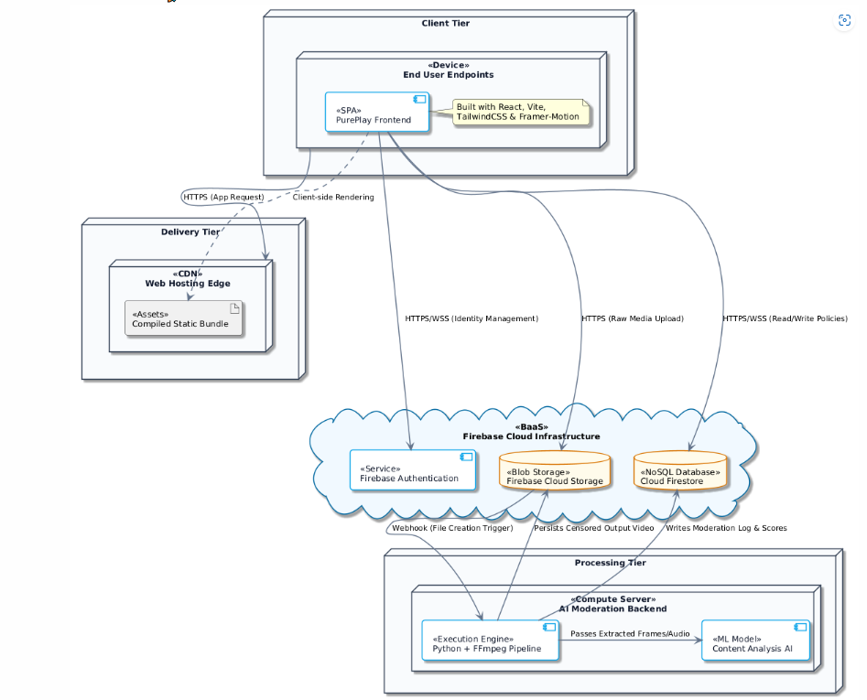
Deployment Architecture

Slide 19
Future Work
• Real-time live-stream moderation
• Mobile application development
• Multilingual toxicity detection
• Improved AI accuracy using larger datasets

Slide 20
Thank You
Questions & Discussion

